Slide 1
MRA Project - MileStone 2
Pavan Kalyan B

Slide 2
TABLE OF CONTENTS:
Problem Statement
Data Analysis
EDA
Market Basket Analysis
Knime
Association rules identified
Recommendations

Slide 3
Problem STATEMENT
A Grocery Store shared the transactional data with you. Your job is to identify the most popular combos that can be suggested to the Grocery Store chain after a thorough analysis of the most commonly occurring sets of menu items in the customer orders. The Store doesn’t have any combo meals. Can you suggest the best combo meals?

Slide 4
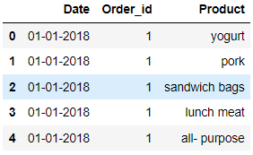
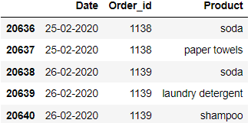
DATA ANALYSIS
The data contains date, order_id and product
First image shows the first 5 rows in the data
Second image shows the last 5 rows in the data
There are 20641 rows and 3 columns

Slide 5
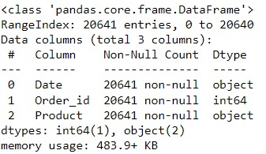
DATA ANALYSIS
There are 20641 rows and 3 columns
2 Columns date and product are object data type
Order_id column is int data type
There is a memory usage of 483.9+ KB
We don’t have any null values in the data

Slide 6
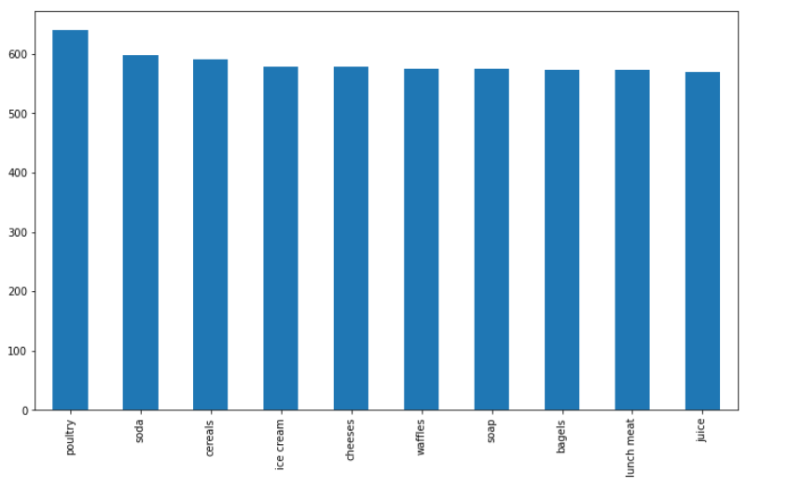
EXPLORATORY DATA ANALYSIS (EDA) :
We have observed that ‘Poultry’ is the highest products saled
These ‘Poultry’ sales are the ones which has the maximum number of orders

Slide 7
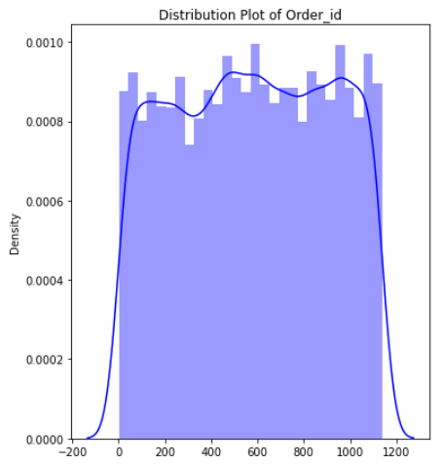
EXPLORATORY DATA ANALYSIS (EDA) :
This histogram plot is for the distribution plot for the order_id column
Moderately Normally distributed

Slide 8
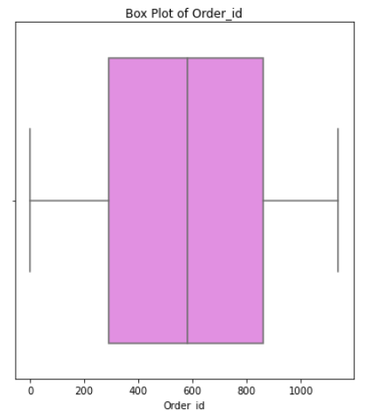
EXPLORATORY DATA ANALYSIS (EDA) :
There are no outliers in the data
We have a mean value of 575.98 and standard deviation of 328.55
1139 is the highest order

Slide 9
Market BasKET ANALYSIS:
Market Based Analysis is a technique which involves understanding of customer purchasing patterns to increase sales which is more efficient for retailers.
This data mining technique uses purchase history of customer in large data sets and the products that are purchased together.
This uses Association rules to analyze the relationship between different objects in a set and to find repeated pattern in a transaction database.
For improving sales in grocery store, this data mining technique will help us in identifying the best suggestion and product combo.
Apriori Algorithm is the commonly used algorithm method in Market Basket Analysis
Apriori Algorithm uses three components such as,
Support
Confidence
Lift

Slide 10
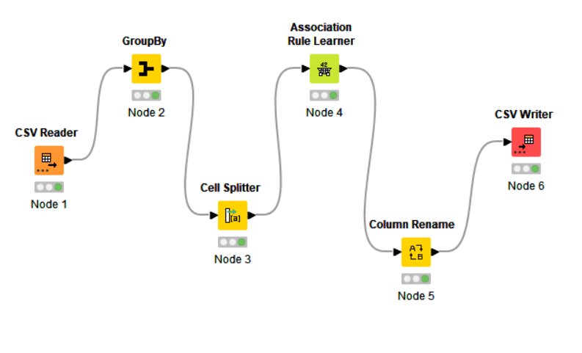
Knime :
I have used python to read and explore the data
I have used knime to perform the market basket analysis and I have used confidence = 0.60 and support = 0.05

Slide 11
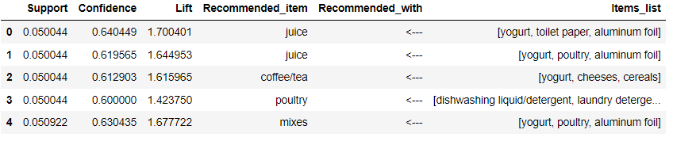
Association RULES:
We have created some item list with recommended items and recommended item with.
For eg: yogurt,toilet,paper,aluminium,foil recommended with juice

Slide 12
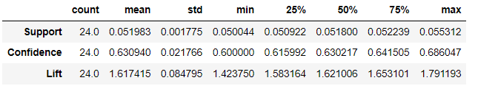
Association RULES:
Support column has minimum of 0.051 and maximum value of 0.055
Confidence has minimum value of 0.60 and maximum value of 0.68
Lift has minimum value of 1.42 and maximum value of 1.79
Confidence has mean of 0.05
Support has mean of 0.63
Lift has mean of 1.61

Slide 13
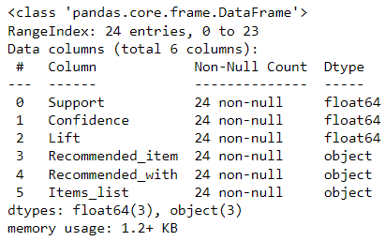
Association RULES:
We can observe that there are 24 rows and 6 columns
3 objects and 3 floats in the columns
There is a memory usage of 1.2+ KB

Slide 14
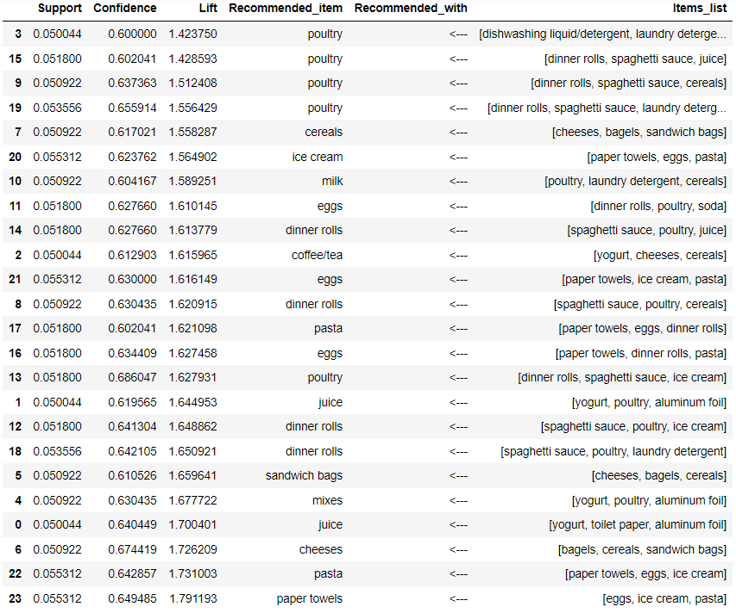
Association RULES:

Slide 15
As per below slide image, Here are the observations
Support : Popularity of an item
The one which has higher support values will have the high sales
Confidence : Probability of customer who bought both items
Higher the probability more likely the combo will works
Mostly like we would want lift to be higher than 1
As we have chosen the minimum support = 0.055 and highest confidence =0.60 for this dataset

Slide 16
Recommendations:
Support : 0.5 and confidence :0.6, our 24 rules lift values are in slide number 14
The rules have more poultry recommendations
New customers are rewarded with points scheme for next purchase
In every year at the Q4, Sales will be profitable
There is a high massive sales at the starting of the year and going on to boost the sales, limited time offers and discounts are given at the end of the year
Possible Combos with Lucrative Offers:
20% off on poultry products with dinner rolls
15% off on soap with poultry purchase
Buy one get one free for paper towels with eggs and icecream
Can track each customer with the loyalty points at the end of the year/month for regular customer

Slide 17
THANK YOU

